Slide 1
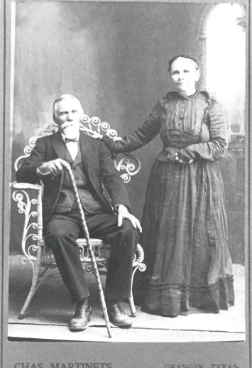
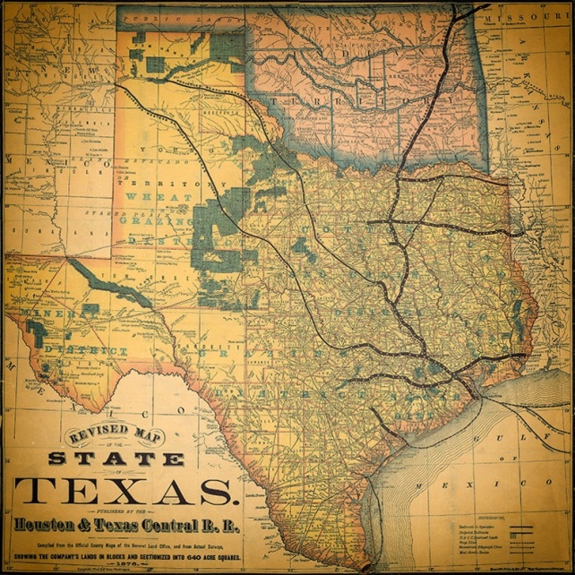
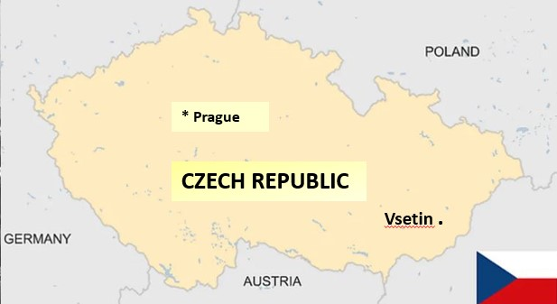

Pavel & Rozina Machu
Arrival in America, 1870.
Machu Family Reunion
Beyersville, Texas
September 22, 2024
This Slideshow available at - www.machu-cemetery.org/gallery.php

Slide 2
Machu Family Reunion
OFFICERS
President: Lisa Whisenant
Vice President: Sandra Strmiska
Treasurer: Kendra Werner
Secretary: Christie Johnson
COMMITTEES
Kitchen: Tina Machu,
Michelle Hawkins,
Sandra Strmiska
Silent Auction: Melody Huber
Facilities: Matt Whisenant
Machu Cemetery Association
OFFICERS
President: Sandra Strmiska
Vice President: Terry Loessin
Treasurer: Lisa Whisenant
Secretary: Debra Haag
Elder Emeritus: Albin F. Machu
WEBSITE:
machu-cemetery.org
Make your plot reservation today!
DONATIONS:
Machu Cemetery Association
c/o Lisa Whisenant
2900 Zachary Lane
Taylor, TX 76574

Slide 3
Family Members Invited to:
Machu Cemetery Association
Annual Meeting
Saturday
October 12, 2024
2:00 p.m.
at
Machu Cemetery Pavilion
Machu Cemetery Association
OFFICERS
President: Sandra Strmiska
Vice President: Terry Loessin
Treasurer: Lisa Whisenant
Secretary: Debra Haag
Elder Emeritus: Albin F. Machu
Website:
machu-cemetery.org
Make your plot reservation today!
Donations:
Machu Cemetery Association
Perpetual Care Fund
c/o Lisa Whisenant
2900 Zachary Lane
Taylor, TX 76574

Slide 4

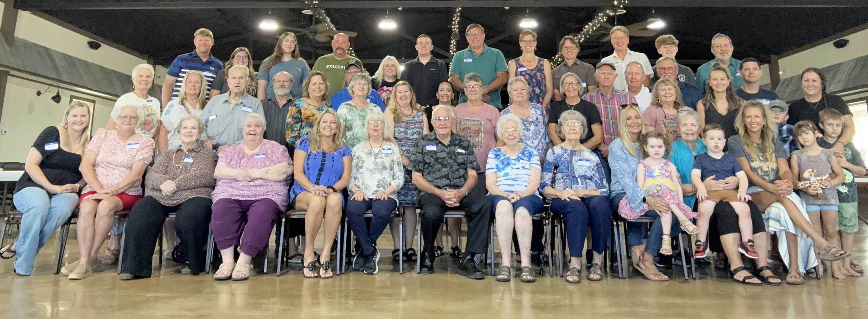
Machu Family Reunion
2023

Slide 5
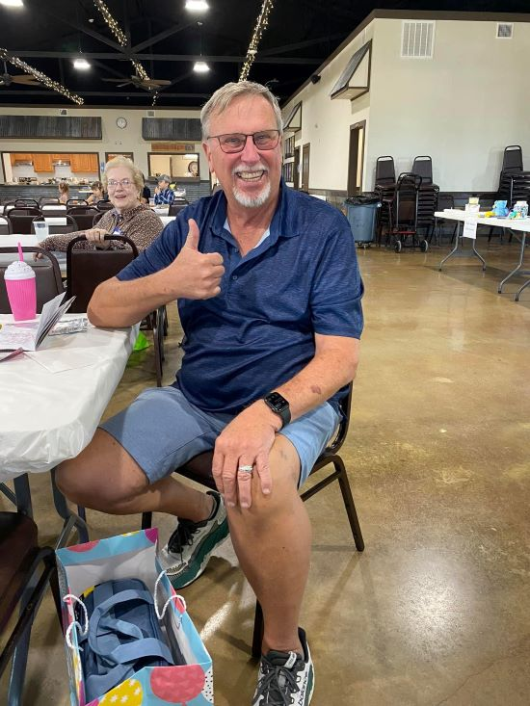
Machu Family Reunion
2023
JIMMY TOWNSEND awarded for
Traveling the Longest Distance!

Slide 6
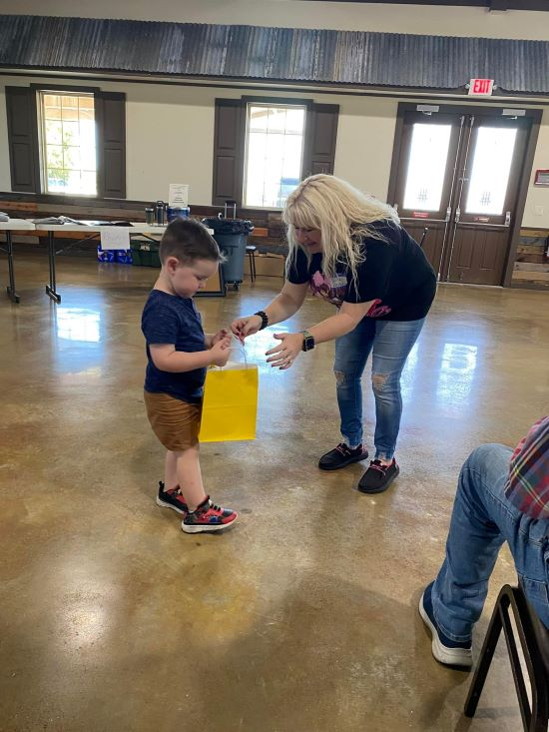
Machu Family Reunion
2023
President Lisa Whisenant
presents
Micah Tucker
the gift for
YOUNGEST ATTENDEE!

Slide 7
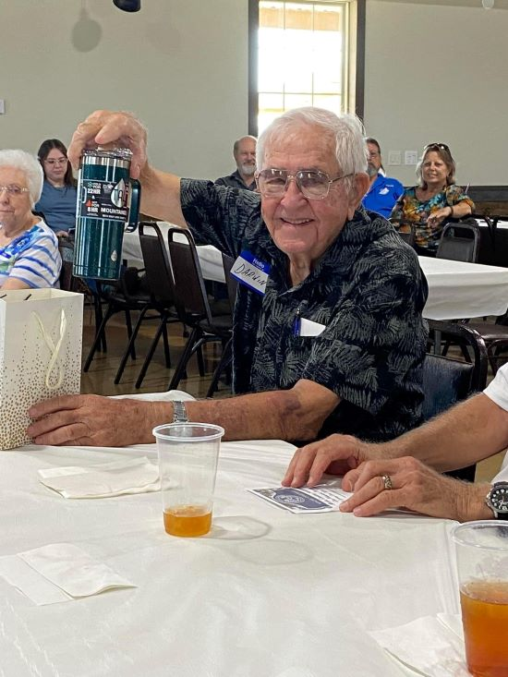
Machu Family Reunion
2023
DARWIN MACHU received gift for
OLDEST ATTENDEE [92 y.o. ! ]

Slide 8

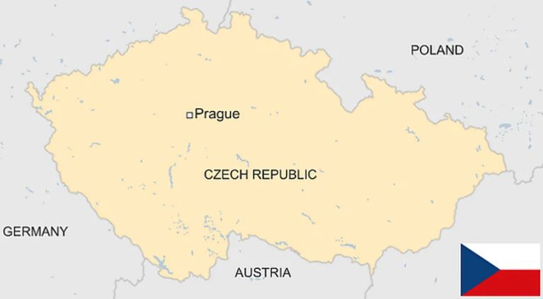
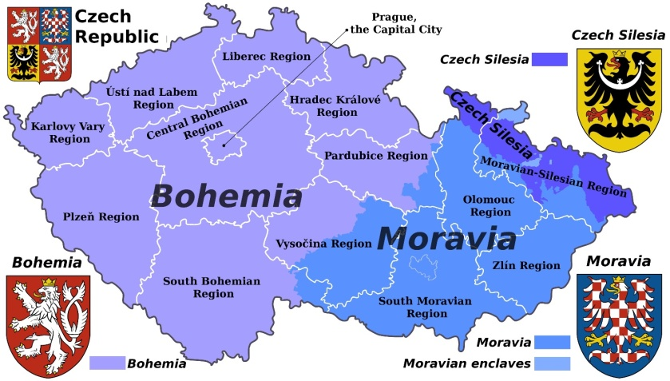
Machu Family
* Prague
CZECH REPUBLIC
Vsetin .
Vsetin
The Machu Family originated in Seninka,
a short distance south of Vsetin
in the eastern, Moravian region of today’s
Czech Republic (or, Czechia).

Slide 9

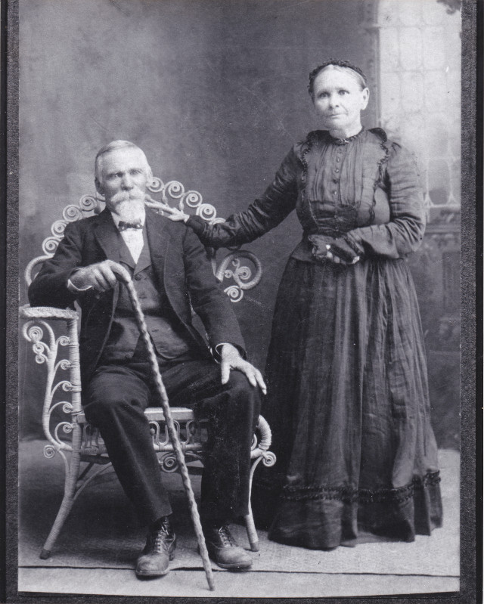
Our Patriarch and Matriarch:
1864: Pavel Machu marries Rozina Trlica.
1870: Pavel applies for permission
to emigrate to the USA.
YOUR MACHU ANCESTORS?
April 7, 1870: The family sets sail
from the port of Bremen, Germany.
June 2, 1870: The Machu family arrives
in Galveston, Texas.
Three children came to U.S. with them:
Anna, who later married Joseph F. Cervenka,
Jan (John) T., who married Veronika Pokorny,
Pavel (Paul) H. who married Rozie Wentrcek.

Slide 10

Jak se máš?
“How are you?"
Traditional greeting phrase for Czechs in the U.S.
Typically, the reply is:
Dobře!
“Good!”

Slide 11
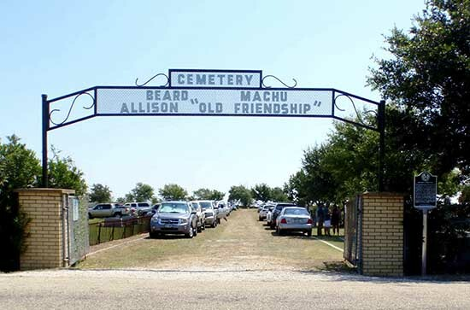
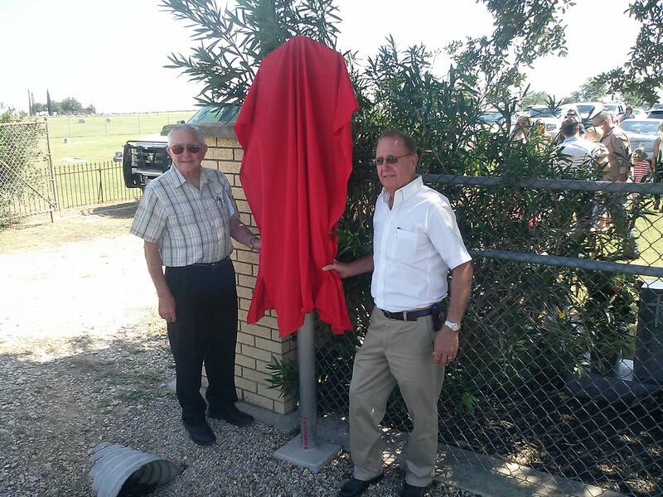
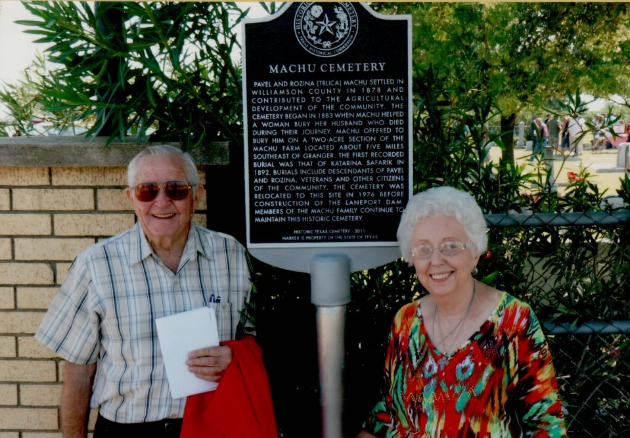
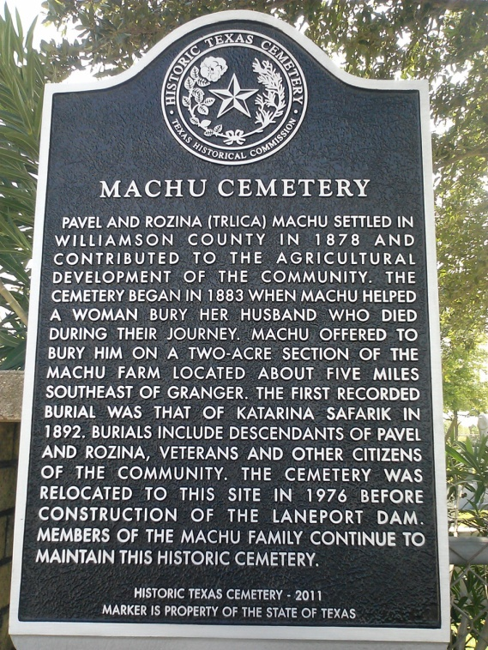
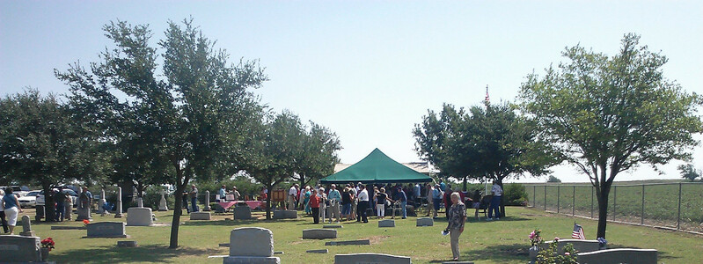
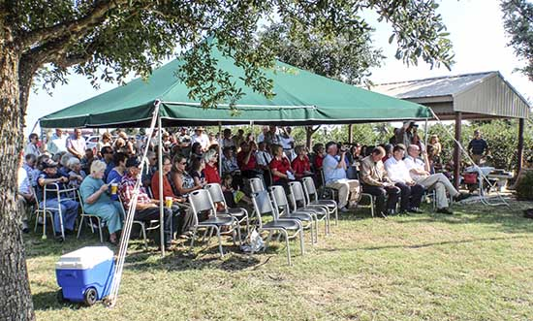
Machu Family
Over 100 attended the Dedication Ceremony for our Cemetery’s Historical Marker on August 17 2013.
Thank you Darwin & Nancy for the research and application work to attain this goal and all who made the special day possible.
Darwin & Albin unveiling Marker

Slide 12
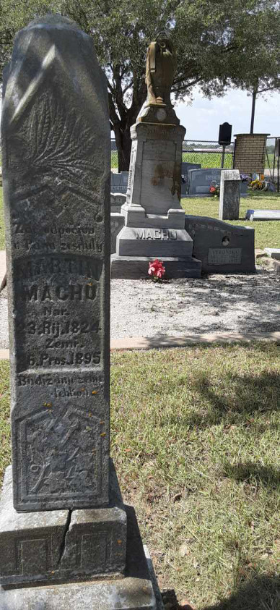
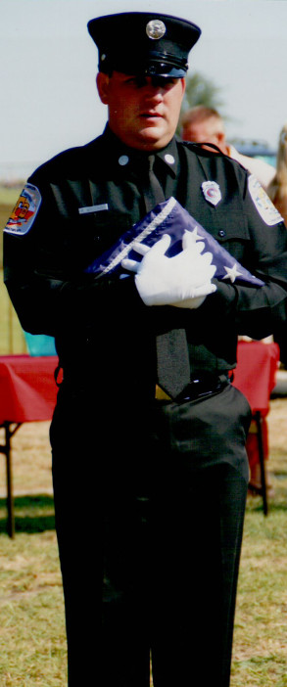
Over 100 attended the Dedication Ceremony for our Cemetery’s Historical Marker on August 17 2013.
Right: The Dedication Ceremony opened with the Presentation
of the Colors
by Matt Whisenant

Slide 13
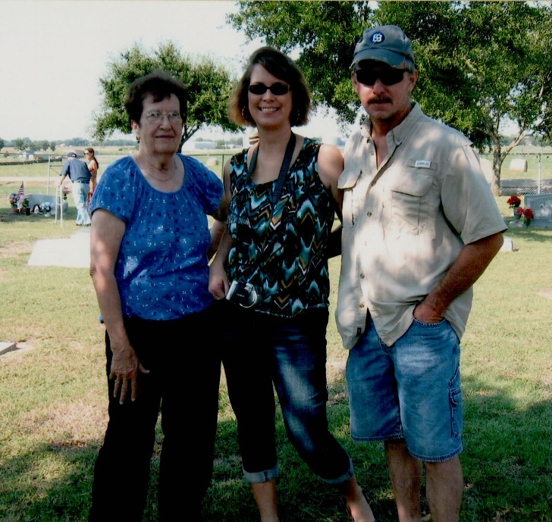
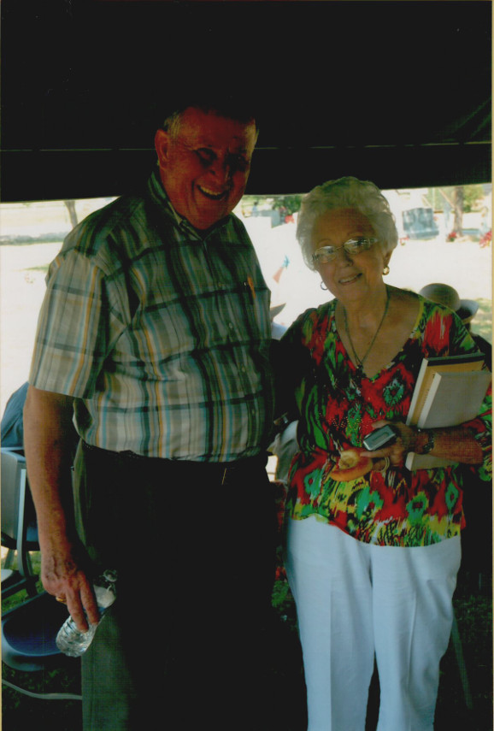
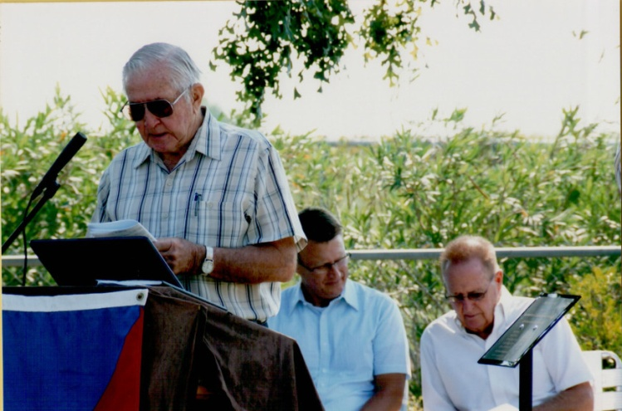
Dedication Ceremony for our Cemetery’s Historical Marker on August 17 2013.
Machu Family
Alice (Machu) Stojanik, Roger & Melody Stojanik Huber;
Henry Holubec with Nancy Machu;
Darwin Machu presenting at ceremony.

Slide 14
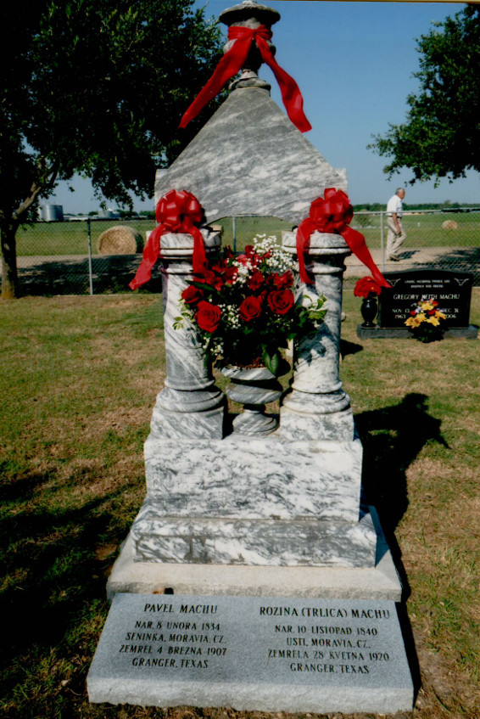
Machu
Family
Cemetery
Our Family’s Jewel
Pavel
&
Rozina’s
Monument
www.machu-cemetery.org/gallery.php

Slide 15
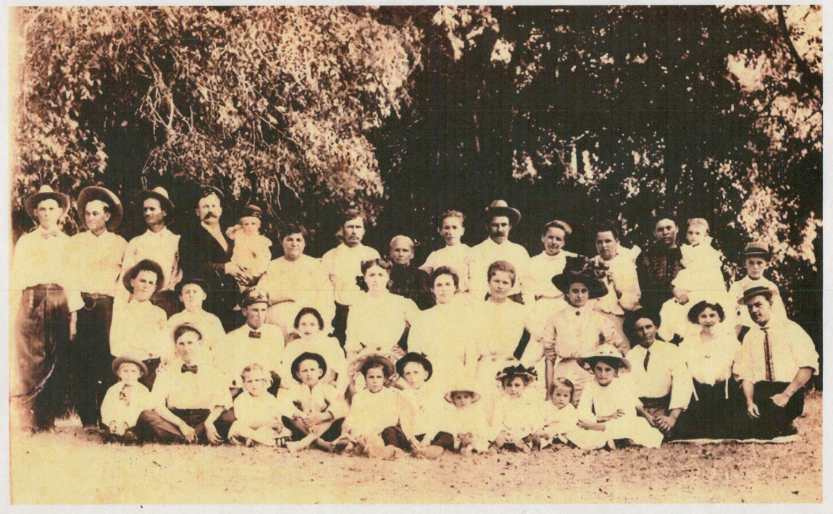
After Pavel died,
Rozina (Trlica) Machu sat for this photo with her entire Machu clan
YOUR MACHU ANCESTORS?

Slide 16
Please
Prosim (proseem)
Thank You
Dekuji (dyekuyi)

Slide 17
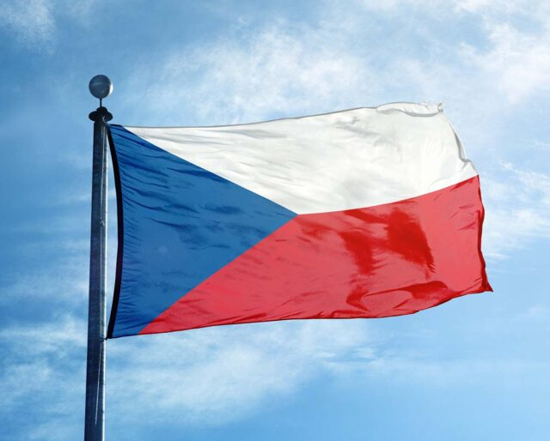
Machu Family
October is Czech Heritage Month,
and many Texas Czechs fly the flag of
their ancestral home during this month.
Czech Founding Day takes place on October 28 every year, a day of celebration and fun because it observes the founding of the first independent Czechoslovakian state.

Slide 18
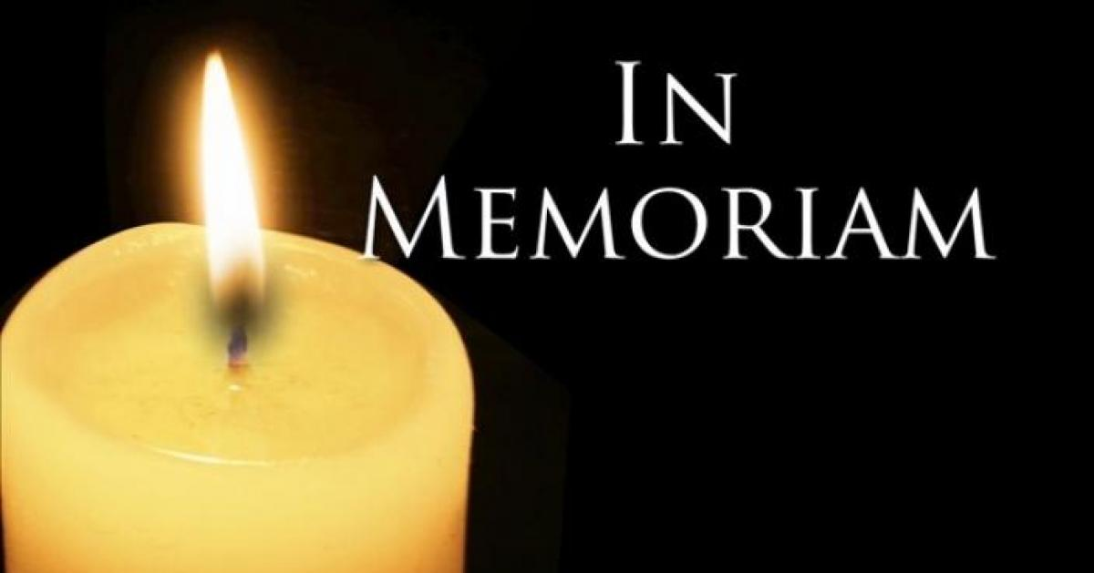
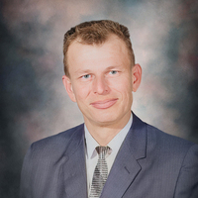
Leslie E. Loessin grew up in Circleville working in his
family’s cotton gin. He attended Circleville School,
and graduated Taylor High in 1954.
Following his 2-year stint in the U. S. Army,
Les married Rubie Machu on April 22, 1961
and the couple had two sons: Terry and Kelly.
Rubie, eldest of Albin E. & Vlasta Machu’s 9 children,
immediately indoctrinated Les (an only child) into her large family’s get-togethers and Les would remain active in the institutions of the Machu family that he had married into throughout their marriage – in service to the family’s cemetery, Granger Brethren church, and SPJST Lodge 20.
Eight months after Rubie’s death in 2023, Les died April 19, 2024
at age 82, in time to rejoin her for their 62nd Wedding Anniversary.

Slide 19
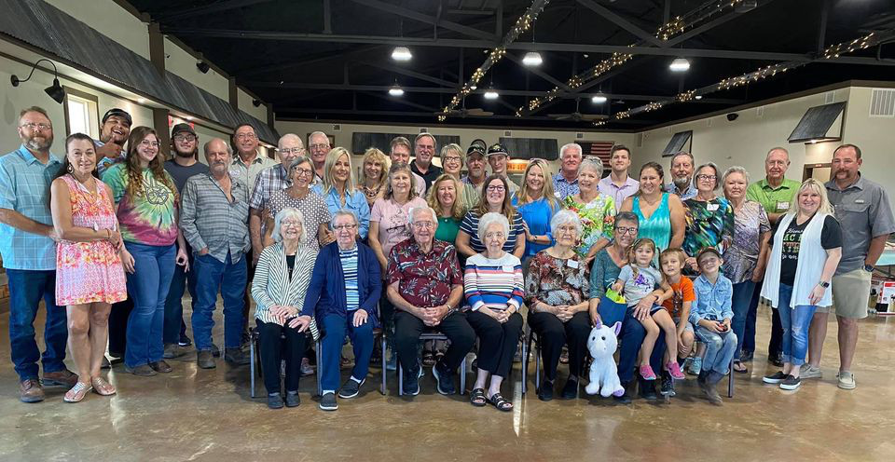
Machu Family Reunion
Beyersville, Texas
2021
3 years ago

Slide 20
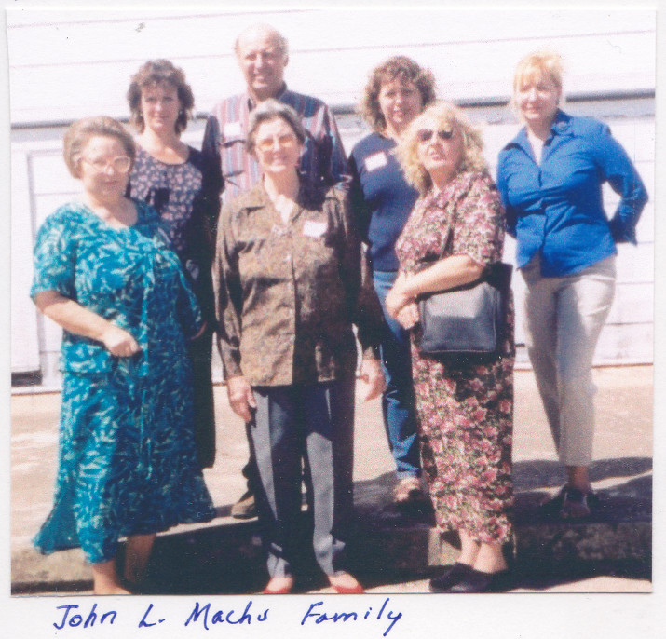
Machu Family Reunion
2003
John L. Machu descendants
21 years ago

Slide 21
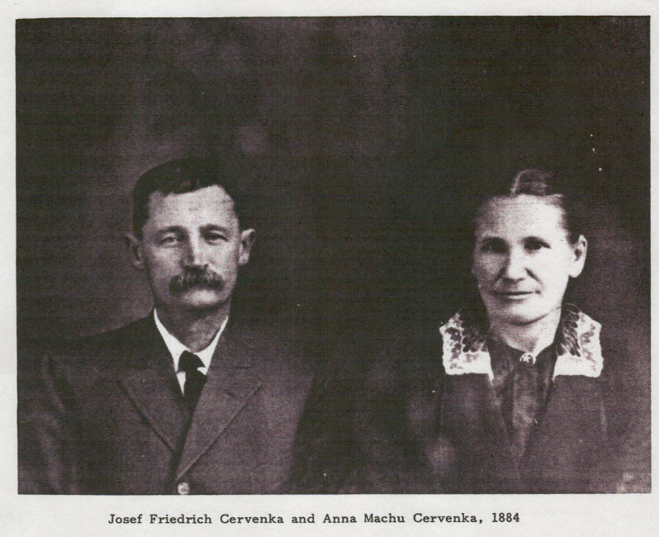
Pavel & Rozina Machu
had 9 children:
Anna, Paul, Rosie, Joe R., Frances, Charles, Mary, Frank Louis, and John T.
YOUR MACHU ANCESTORS?
Josef and
Anna Machu Cervenka
in 1884

Slide 22
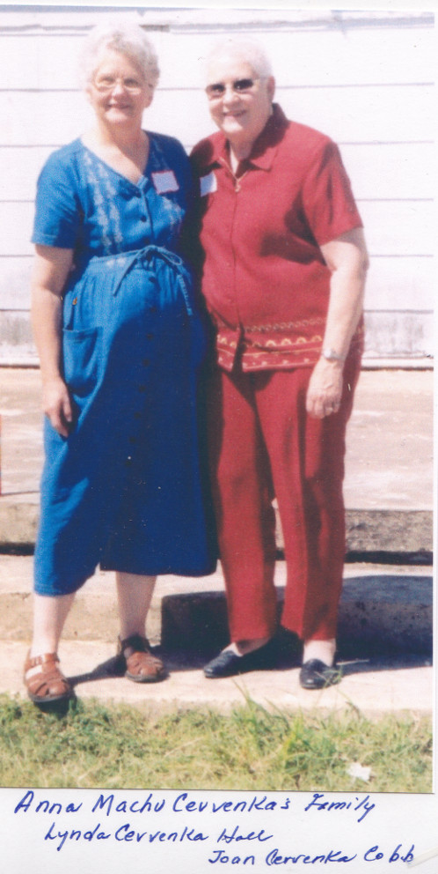
Machu Family Reunion
2003
Anna Machu Cervenka’s descendants
21 years ago
Lynda Cervenka Hall
Joan Cervenka Cobb

Slide 23
1 – Jedna
2 – dva
3 – tři
4 – čtyři
5 – pět
6 – šest
7 – sedm
8 – osm
9 – devět
10 – deset

Slide 24
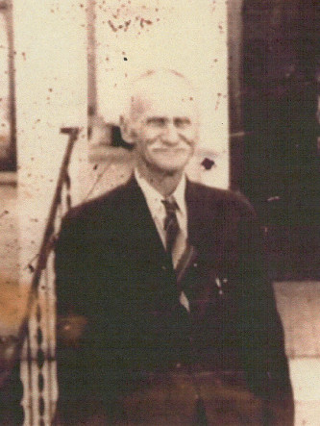
Pavel & Rozina Machu
had 9 children:
Anna, Paul, Rosie, Joe R., Frances, Charles, Mary, Frank Louis, and John T.
YOUR MACHU ANCESTORS?

Slide 25
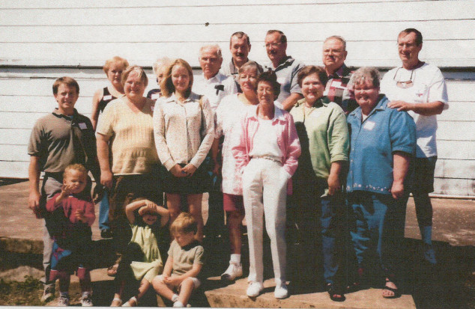
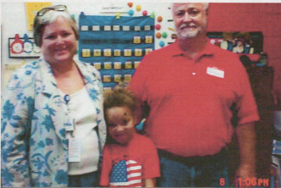
YOUR MACHU ANCESTORS?
Paul H. Machu (left) descendants, including
Cindy and Monk Montgomery (right)

Slide 26
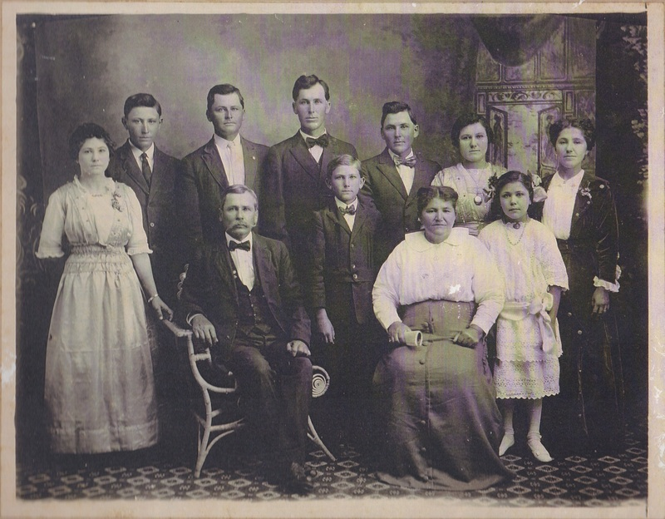
Our Patriarch and Matriarch:
Pavel & Rozina Machu
had 9 children:
Anna, Paul, Rosie, Joe R., Frances, Charles, Mary, Frank Louis, and John T.
YOUR MACHU ANCESTORS?
Pictured :
John T. Machu
and his wife Veronika (Pokorny)
and their 9 children.

Slide 27
Pictured :
John T. Machu and his wife Veronika (Pokorny)
and their 9 children: (from left)
Vera, Anton P., John L., Joe M., Raymond,
Frank R., Rosie, Bertha, and young Albina.
YOUR MACHU ANCESTORS?
John T. Machu was 3 y.o. when he immigrated from Usti, Moravia to Texas in 1870 with his parents Pavel and Rozina (Trlica) Machu. Veronika was 11 when she immigrated from Polanka, Moravia to Texas in 1881 with her parents Josef and Rozina (Belicek) Pokorny.

Slide 28
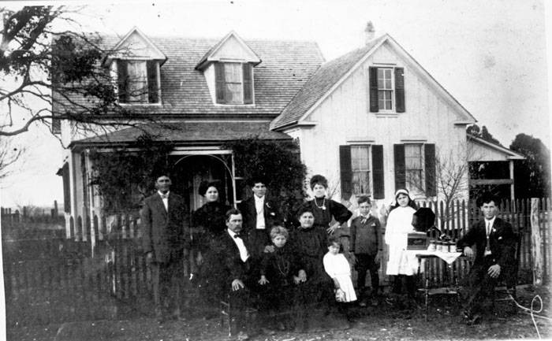
Pictured :
John T. Machu
and his wife Veronika (Pokorny)
and their 9 children.
YOUR MACHU ANCESTORS?
Like many families at photo time,
a son could not be pulled away from his tech gadget –
in this case,
Joe M. keeps his Victrola at close at hand!

Slide 29
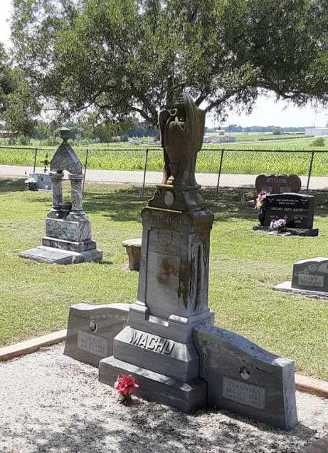
Pictured :
John T. Machu
and his wife Veronika (Pokorny)
have one of the more
impressive monuments at the
Machu Family Cemetery.
The couple were active pillars
in the life of their Czech
community in Williamson County, while raising their nine
children.
John T. was a leader at the local and state level in the Czech Brethren Church and S.P.J.S.T.
YOUR MACHU ANCESTORS?

Slide 30

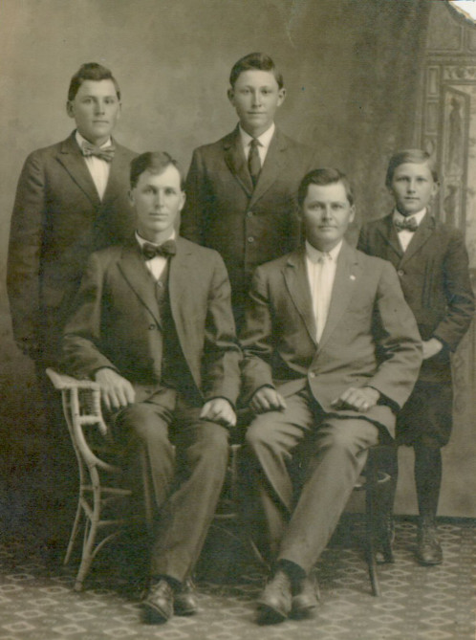
YOUR MACHU ANCESTORS?
The sons of
John T. Machu:
Joe, John,
Frank, Anton, Raymond

Slide 31
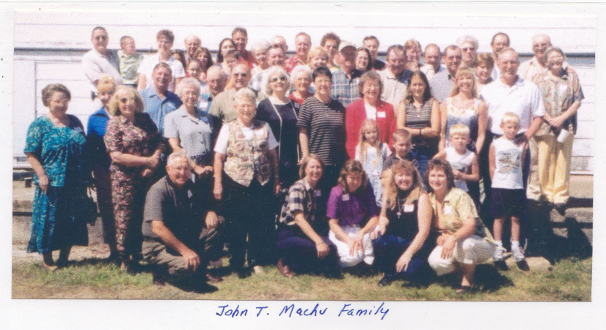
Machu Family Reunion
2003
John T. Machu descendants
21 years ago

Slide 32
Bez práce nejsou koláče.
“Without work, there are no koláčes!”
A meaningful proverb that,
not surprisingly,
reflects the Czech culture’s work ethic!

Slide 33
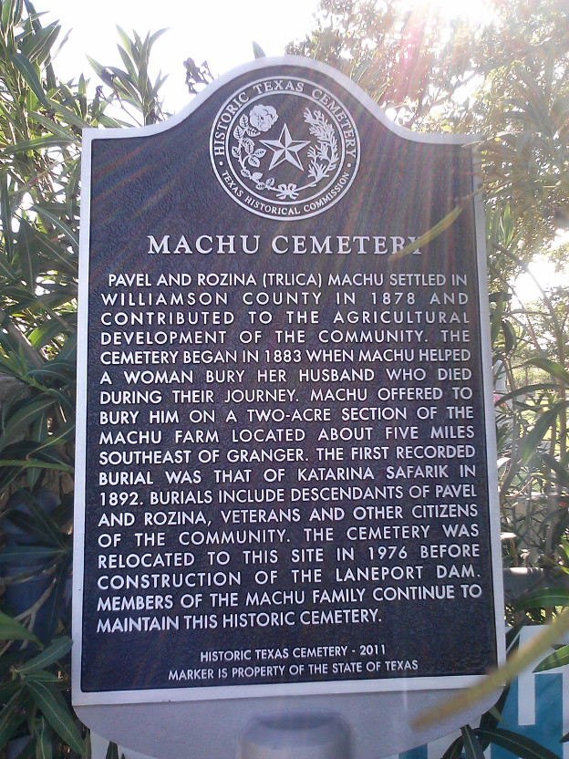
Please consider making a Memorial Donation in the name of a loved one toward the Perpetual Care and Restoration projects of our Cemetery.
Send donations to:
Machu Cemetery Association
c/o Lisa Whisenant
2900 Zachary Lane
Taylor, TX 76574
machu-cemetery.org

Slide 34

Over 40 Archival Photos
WOULD YOU LIKE A COPY
OF THIS PRESENTATION?
HERE IS A GREAT RESOURCE
FOR INTRODUCING YOUR YOUNGSTERS
(and those new In-Laws)
TO OUR FAMILY HISTORY & ANCESTORS
View Anytime or Download it at:
Machu-cemetery.org/Gallery.php

Slide 35
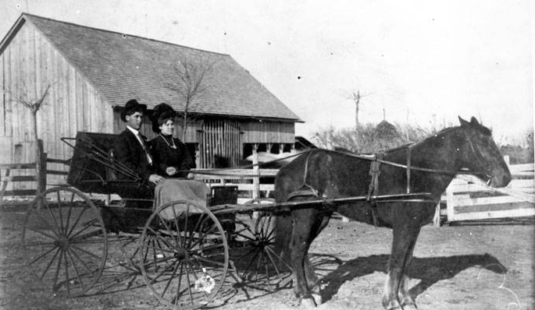
Can you identify this smartly dressed church-going couple?
YOUR MACHU ANCESTORS?
Joe and Albina Machu; circa 1905

Slide 36
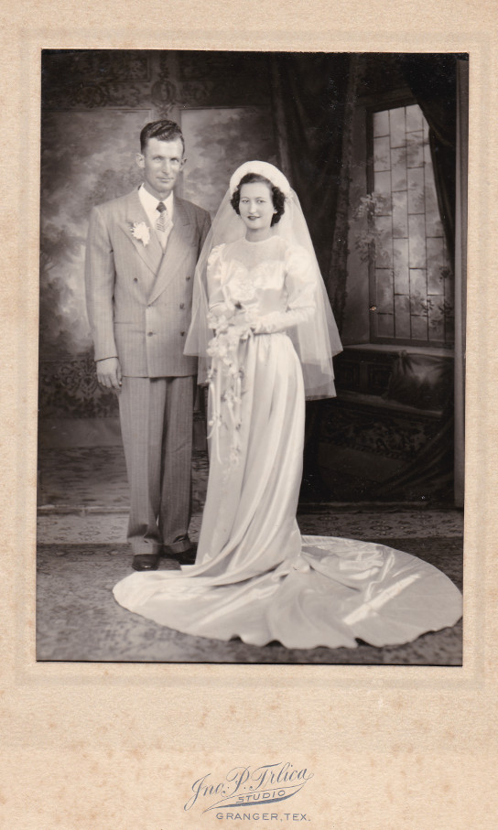
YOUR MACHU ANCESTORS?
Can you identify this couple?
It is

Slide 37
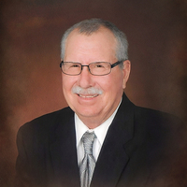
Marvin Joe Machu was born on November 7th, 1947
to Albin E. Machu and Vlasta Kovar Machu. He went to
school in Granger and later attended Central Texas College in Killeen studying drafting for his job at Westinghouse. He then had a 27-year career at the University of Texas at Austin. After retiring from UT, he worked part time at Thorndale ISD.
Marvin wed Barbara Muegge on August 8th, 1970, at St. Paul Lutheran Church in Thorndale. He was an active member of that church, serving as one of the trustees and volunteering his skills at its school.
Marvin was called to his heavenly home February 14th, 2024
at the age of 76, surrounded by his loving family, including
Barb, their daughter Sheri & husband Greg Lowry, loving
granddaughter Olive and great nephew Jordin Morgan.

Slide 38
Dobrá rada nad zlato.
“Good advice is better than gold.”
Hněv je špatný rádce.
“Anger is a bad advisor.”

Slide 39
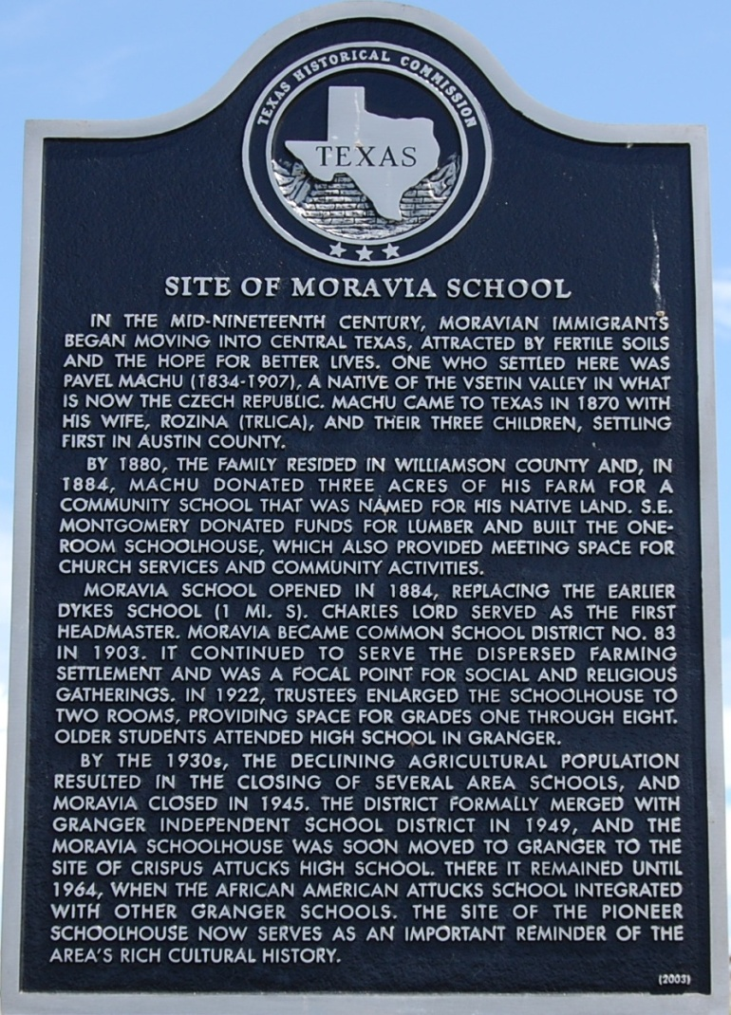
Machu Family
Imagine - an immigrant with no education and limited English, Pavel managed to provide a school in central Texas for the children of his fellow countrymen from Moravia.
Pavel Machu committed himself to getting the Moravia School built, aided by other farmers living nearby.
He donated a portion of his farm for the school and traveled to surrounding towns on horseback, soliciting funds for construction costs.

Slide 40
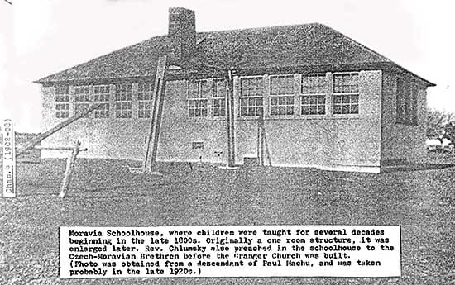
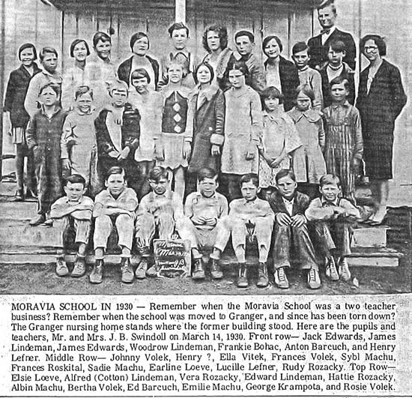
Pavel Machu committed himself to getting the Moravia School built.
Machu Family

Slide 41
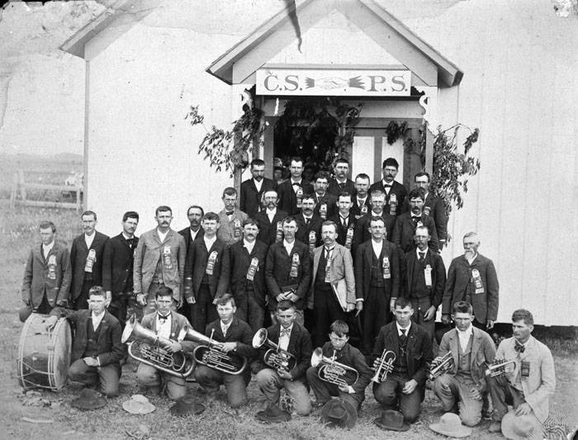
In addition to his efforts to found the Moravian School for his Czech community, Pavel was also instrumental in forming a fraternal insurance agency to aid his Czech neighbors in need.
Machu Family
That early agency was
the Cesko-Slovanska Podporujici Spolecnost (CSPS) Lodge in Granger.
The CSPS was absorbed by SPJST organization after 1897..

Slide 42
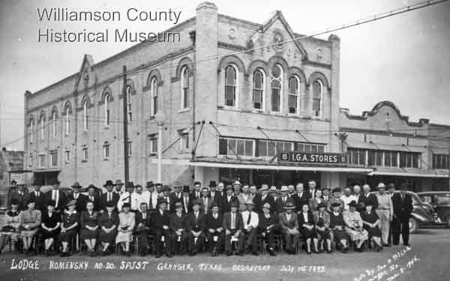
Machu Family
Pavel and Rozina were among the founding members of Granger's Lodge 20 of the Czech fraternal insurance group SPJST. Members posed here in front of the lodge hall, a city property the lodge purchased from Rozina
in 1907.
Photo taken by Pavel and Rozina's nephew John P. Trlica, the well-known Granger photographer.

Slide 43
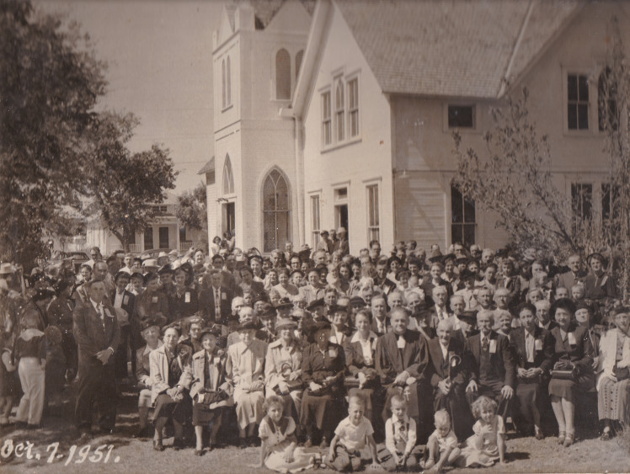
Pavel and Rozina were instrumental in establishing the first Czech Protestant church
in central Texas, the Czech Moravian Brethren Church, a denomination whose origins date
back to the 15th century Hussites of Czech Bohemia. The first church services in the area were held at the Moravia School.
Machu Family
Pavel and Rozina’s children and grandchildren’s rites of passage centered around the Brethren Church.
In this 1951 pic of a
State Convention are 25 Machu family members!

Slide 44
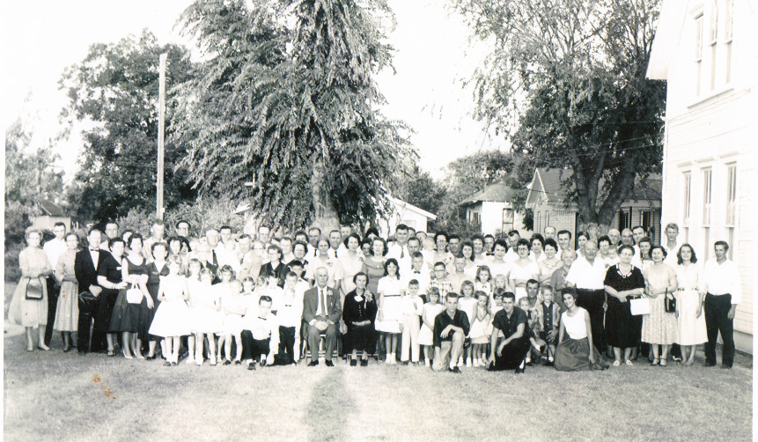
All of Pavel and Rozina’s
children and grandchildren’s
rites of passage
centered around the Brethren Church
Below, their grandson Joe M. Machu and wife Tracy (Zetak) celebrate their 60th anniversary with the Machu clan.
Machu Family
1962

Slide 45
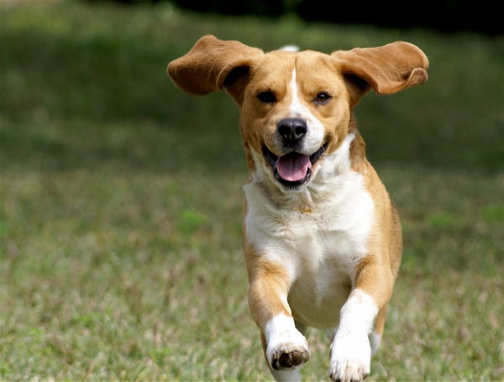

Pes
Kočka

Slide 46


YOUR MACHU ANCESTORS?
Anton & Millie (Kveton) Machu

Slide 47

YOUR MACHU ANCESTORS?

Slide 48


VETERANS
YOUR MACHU ANCESTORS?
World War I Veteran Frank Machu
Left: Frank and John L. Machu

Slide 49

Descending from the Martin Machu line is:
Pfc Clarence E. Machu, son of Mr. and Mrs. Emil Machu of Manor, Texas.
During World War II Clarence volunteered for service Feb. 10, 1943, at Austin. He was assigned to the 2nd Marines, and was trained at San Diego and Camp Elliott, California.
He served overseas from July 1, 1943, until May 1, 1945, in New Caledonia, New Zealand, Hawaii, and fought in the battles of Tarawa, Saipan, Guam, and Iwo Jima.
Awards include: two Presidential Unit Citations, one Navy Unit Citation, and the Asiatic Pacific Campaign Ribbon with 4 Bronze Stars.
YOUR MACHU ANCESTORS?
VETERANS

Slide 50


Anton Ludwig Pokorny
was born in Taylor, Texas
August 25, 1920
and passed away
February 1, 2019.
YOUR MACHU ANCESTORS?
VETERANS
Anton was a WWII veteran and served as an Army Maintenance Motor Sergeant in the 77th Field Artillery.
After the war, he and wife Fay moved to California with sons Anton and Oscar where he worked for Lockheed Martin for 29 years.
Awards include: The bronze star and
six battle stars.

Slide 51

Darwin L. Machu
was born in Granger, Texas on July 8, 1931 to Anton & Millie [Kveton] Machu.
Darwin would marry wife Nancy [Bryan] and they raised son Greg and daughter Rhonda. They are active today in their retirement promoting and preserving Czech history and culture.
YOUR MACHU ANCESTORS?
VETERANS
Darwin was inducted into the U.S. Army in 1952 and did his basic training at Camp Roberts in California. Because of his fluency in Czech he was assigned to the 513th Military Intelligence Service in Germany.
He served as Companion to people who had escaped from behind the Iron Curtain and had asked for asylum.
Corporal Darwin Machu was discharged on September 19, 1953.

Slide 52

Descending from the John T. Machu line is:
Albin F. Machu, son of Mr. & Mrs. Albin E. Machu of Granger, Texas.
During the Vietnam Confict Albin served in the United States Marine Corps’ 3rd Battalion; 23rd Marines; 4th Marine Division.
1964-1970: State-Side Marine Corps Reserve; Camp Pendleton; San Diego, California.
YOUR MACHU ANCESTORS?
VETERANS
Combat Training – Camp Swift, Bastrop TX; Duties included Infantry Division, Truck Driver, Honor Guard.
1966, Albin’s Marine Unit’s First Tour of Duty to Vietnam was, within hours of departure,
called off by President Lyndon B. Johnson.
Serving in the Honor Guard (1966-70) Albin was called upon to attend many funerals for fallen Marines from the central Texas area.

Slide 53


WWII Veteran
Clarence E Machu
YOUR MACHU ANCESTORS?
WWII Veteran
Daniel Thomas Blaha
Sergeant, U.S. Marines
VETERANS
WWI Veteran
Frank Machu
Brandon Johnson
U.S. Army 1991-94;
TX National Guard
2014-present
Cold War Veteran
Darwin L Machu
Vietnam War Veteran
Albin F Machu

Slide 54


Hattie Machu
confirmation photo.
YOUR MACHU ANCESTORS?
Hattie Machu Holubec Kollaja with her
grand-nephews Terry and Kelly Loessin. She baked 3 cakes for Terry’s confirmation!

Slide 55

YOUR MACHU ANCESTORS?
Four Generations of Machus:
Albin E., Joe M., John T.
Albin F. in foreground.

Slide 56

YOUR MACHU ANCESTORS?
Four Generations:
Joe M. Machu, Albin E. Machu, Albin F. Machu, Terry Loessin

Slide 57
Family = Rodina
Mother = Matka Father = Otec
Mom = Maminka Dad = Táto
Grandma = Babička Grandpa = Dědeček
Children = Děti
Son = Syn boy = chlapec
Daughter = Dcera girl = dívka

Slide 58

Our Patriarch and Matriarch:
Pavel & Rozina Machu
had 9 children:
Anna, Paul, Rosie, Joe R., Frances, Charles, Mary, Frank Louis, and John T.
YOUR MACHU ANCESTORS?
Pictured :
Charles Machu
and his wife Frances (Mickolas).

Slide 59

Pavel & Rozina Machu
had 9 children:
Anna, Paul, Rosie, Joe R., Frances, Charles, Mary, Frank Louis, and John T.
YOUR MACHU ANCESTORS?
Pictured :
Joe R. Machu
and his wife Marie (Wentrcek).

Slide 60

Pavel & Rozina Machu
had 9 children:
Anna, Paul, Rosie, Joe R., Frances, Charles, Mary, Frank Louis, and John T.
YOUR MACHU ANCESTORS?
Frances Machu with
Frank Shiller and
adopted son Frank
in the Machu store
East Davilla St.
in Granger, TX

Slide 61

Butchers in street outside the adjacent meat market beside the J. R. Machu Grocery Store, Granger, Texas, ca. 1903.

Slide 62
Hi! I am ______
Ahoj! Já jsem ______
What is your name?
Jak se jmenuješ?
Glad to meet you!
Rád tě poznávám!

Slide 63


Pavel & Rozina Machu
had 9 children:
Anna, Paul, Rosie, Joe R., Frances, Charles, Mary, Frank Louis, and John T.
YOUR MACHU ANCESTORS?
Rosie Machu
married Henry Rozacky

Slide 64

Leroy Albert Filla was born on September 30, 1935,
in Coupland to Leo and Vlasta (Machu) Filla.
He was the oldest of five children. Leroy graduated from Granger High School, served in the National Guard, and was a lifetime active member in the Brethren Church.
He married Janice Tomlinson and the couple had four children:
Gary, Carolyn, Brenda and Tommy.
Leroy was an avid farmer and never officially retired. Continuing to
work from sun up to sun down, he could be found
on a lawn mower mowing cemeteries, or on his
farm working cattle. And Leroy enjoyed hosting all
the family events and holidays.
Leroy passed away Thursday, April 4, 2024.

Slide 65

YOUR MACHU ANCESTORS?
John and Frances Machu

Slide 66

YOUR MACHU ANCESTORS?
Alice Machu marries
Edwin Stojanik

Slide 67


Good day (How do you do)
Dobry den (dobree den)
Good morning
Dobre rano
(dobreh rahno)
Good night
Dobrou noč
(dobrow nots)
Prague at morning
Prague at night

Slide 68
Machu Family Reunion
OFFICERS
President: Lisa Whisenant
Vice President: Sandra Strmiska
Treasurer: Kendra Werner
Secretary: Christie Johnson
COMMITTEES
Kitchen: Tina Machu,
Michelle Hawkins,
Sandra Strmiska
Silent Auction: Melody Huber
Facilities: Matt Whisenant
Machu Cemetery Association
OFFICERS
President: Sandra Strmiska
Vice President: Terry Loessin
Treasurer: Lisa Whisenant
Secretary: Debra Haag
Elder Emeritus: Albin F. Machu
Website:
machu-cemetery.org
Make your plot reservation today!
Donations:
Machu Cemetery Association
c/o Lisa Whisenant
2900 Zachary Lane
Taylor, TX 76574

Slide 69
Family Members Invited to:
Machu Cemetery Association
Annual Meeting
Saturday
October 12, 2024
2:00 p.m.
at
Machu Cemetery Pavilion
Machu Cemetery Association
OFFICERS
President: Sandra Strmiska
Vice President: Terry Loessin
Treasurer: Lisa Whisenant
Secretary: Debra Haag
Elder Emeritus: Albin F. Machu
Website:
machu-cemetery.org
Make your plot reservation today!
Donations:
Machu Cemetery Association
Perpetual Care Fund
c/o Lisa Whisenant
2900 Zachary Lane
Taylor, TX 76574

Slide 70


Machu
Family
Cemetery
Our Family’s Jewel
What a beautiful setting.
The Pavilion provides funeral attendees shade on hot sunny days and shelter from rain.
And on our family workdays,
we break bread together here and share in a bit of svacina (breaktime snacks!)

Slide 71


Machu
Family
Cemetery
Our Family’s Jewel
Meditation Corner.
The Cemetery’s Cross, a donation from the Albin E. Machu family, serves to remind visitors to our cemetery of our family’s Christian heritage and, as well, assures all who mourn here of the promise that this religious symbol holds for Christians
of the forgiveness of sins and life eternal.

Slide 72


Machu
Family
Cemetery
Albin E. Machu was instrumental in assisting the United States Corps of Engineers with the relocation of the cemetery in 1977 and would be honored in 1981 with a Take Pride in America plaque presented by the U.S. Corps of Engineers.
Our Family’s Jewel
And not just for his work with the cemetery but also for his work "providing sight reports of protected wildlife species and his volunteer efforts that helped establish the multiple game preserves enjoyed around the lake area today."

Slide 73

The Machu Family Cemetery contains
900 burial plots and presently has over
200 identified graves with tombstones and
60 graves of unknown persons on the
3-acre site it was relocated to in
1976.
Machu Family
Our Family’s Jewel
Rededication ceremonies
were held on May 29, 1977
Have you and your loved ones reserved your own plots?
Machu-cemetery.org

Slide 74

Rain!
Déšť!
We need rain!
Potřebujeme déšť!
Rainy Day on Charles Bridge; Prague, CZ

Slide 75



Machu
Family
Cemetery
THERE IS ALWAYS WORK TO BE DONE
Our Work Days posted 2-weeks prior at
machu-cemetery.org/eventscalendar
Our Family’s Jewel
Rhonda Roten
doing great job
cleaning the headstones!
Next
Workday
is
Saturday
Oct. 5
8 - 12
Victor Joe Holubec and
Albin F. Machu go after it
on potty detail!

Slide 76






Machu
Family
Cemetery
Our Family’s Jewel
Thank you Albin F. Machu for your years of dedicated volunteer service to our family’s historic cemetery. Your commitment to watering saplings that grew to be beautiful trees, tree trimming, coordinating with City staff and Funeral homes, orchestrating burials, ensuring the potty and lawn cared for, installation of infrastructure, and this list goes on… Your years of service are an inspiration to us all.
Notes:
our

Slide 77
Over 40 Archival Photos
WOULD YOU LIKE A COPY
OF THIS PRESENTATION?
HERE IS A GREAT RESOURCE
FOR INTRODUCING YOUR YOUNGSTERS
(and those new In-Laws)
TO OUR FAMILY HISTORY & ANCESTORS
View Anytime or Download it at:
Machu-cemetery.org/Gallery.php

Slide 78



Machu
Family
Cemetery
THERE IS ALWAYS WORK TO BE DONE
Our Work Days posted 2-weeks prior at
machu-cemetery.org/eventscalendar
Our Family’s Jewel
On the Riding Mowers:
Angie Malicoat
T. J. Mikulec
Leslie Loessin
Next
Workday
is
Saturday
Oct. 5
8 - 12

Slide 79


Machu
Family
Cemetery
THERE IS ALWAYS WORK TO BE DONE
Our Work Days posted 2-weeks prior at
machu-cemetery.org/eventscalendar
Our Family’s Jewel
Next
Workday
is
Saturday
Oct. 5
8 - 12
Angie Malicoat regularly volunteers on Cemetery Workdays, here with brother Marvin Machu and nephew Terry Loessin
loves pushing mower!

Slide 80


Machu
Family
Cemetery
THERE IS ALWAYS WORK TO BE DONE
Our Work Days posted 2-weeks prior at
machu-cemetery.org/eventscalendar
Our Family’s Jewel
Next
Workday
is
Saturday
Oct. 5
8 - 12
Left: Machu Cemetery Association President Sandra Strmiska
giving it her all!
Right:
Sharon Mikulec
wielding a weedeater and making it all pretty!

Slide 81


Machu
Family
Cemetery
THERE IS ALWAYS WORK TO BE DONE
Our Work Days posted 2-weeks prior at
machu-cemetery.org/eventscalendar
Our Family’s Jewel
Next
Workday
is
Saturday
Sept. 30
8 - 12
Next
Workday
is
Saturday
Oct. 5
8 - 12
Debbie Haag & Rubie Loessin
working the waterhoses, and
(at right) Kolton Whisenant
pruning an oleander!

Slide 82
God
Bůh
God bless you
Bůh ti žehnej

Slide 83
God
Bůh
God bless you
Bůh ti žehnej
THE LORD’S PRAYER:
Our Father, who art in heaven,
hallowed be thy name;
thy kingdom come,
thy will be done,
on earth as it is in heaven.
Give us this day, our daily bread,
and forgive us our trespasses
as we forgive those who trespass against us.
And lead us not into temptation,
but deliver us from evil.
Amen.
Otče náš, jenž jsi v nebesích,
posvéť se jméno tvé;
prijd' království tvé,
bud' vůle tvá,
jako v nebi, tak i na zemi.
Chléb náš vezdejší dej nám dnes,
a otpusť nám naše viny,
jakož i my odpousťíme naším vinníkům.
A ne uvod' nás v pokušení,
ale zbav nás od zlého.
Amen.

Slide 84


Pavel & Rozina’s grandson Joe M. Machu
(son of John T.) married Tracy Zetak
in a huge double wedding with John L. Machu and Frances Kopecky.
Left: Joe and Tracy Machu with children
Vlasta, Hattie, and Albin E. on knee.
Right: Expanded family with daughters Mildred
and Alice added, and grandchildren.
YOUR MACHU ANCESTORS?

Slide 85



YOUR MACHU ANCESTORS?
Above: Albin E. Machu,
Hattie Machu Holubec Kollaja,
Sybil Machu Stojanik,
Mildred Machu Townsend
Left: Albin E., Hattie, Sybil and Vlasta Machu

Slide 86

Edward and Mildred Machu Townsend wedding
Attendants: Edwin and Alice Machu Stojanik
YOUR MACHU ANCESTORS?

Slide 87


Willie and Sybil Machu Stojanik wedding
Below left: Sybil Machu, age 2, in 1918.
YOUR MACHU ANCESTORS?

Slide 88


Please consider making a Memorial Donation in the name of a loved one toward the Perpetual Care and Restoration projects of our Cemetery.
Send donations to:
Machu Cemetery Association
c/o Lisa Whisenant
2900 Zachary Lane
Taylor, TX 76574
machu-cemetery.org

Slide 89
Over 40 Archival Photos
WOULD YOU LIKE A COPY
OF THIS PRESENTATION?
HERE IS A GREAT RESOURCE
FOR INTRODUCING YOUR YOUNGSTERS
(and those new In-Laws)
TO OUR FAMILY HISTORY & ANCESTORS
View Anytime or Download it at:
Machu-cemetery.org/Gallery.php

Slide 90





Have an Event you need equipment for?
See Terry for rentals!
Portable P.A. System
Projector
Presentation Screen
6’ Folding Tables
Crockpot Trio
& more!

Slide 91
The traditional Czech farewell / goodbye:
S pánem Bohem!
“God be with us!”

